Slide 1
Why R Markdown?
RX 319
Introduction to Healthcare Analytics

Slide 2
Learning Objectives
Describe the benefits of R Markdown.
Describe the components of an R Markdown report.
2

Slide 3
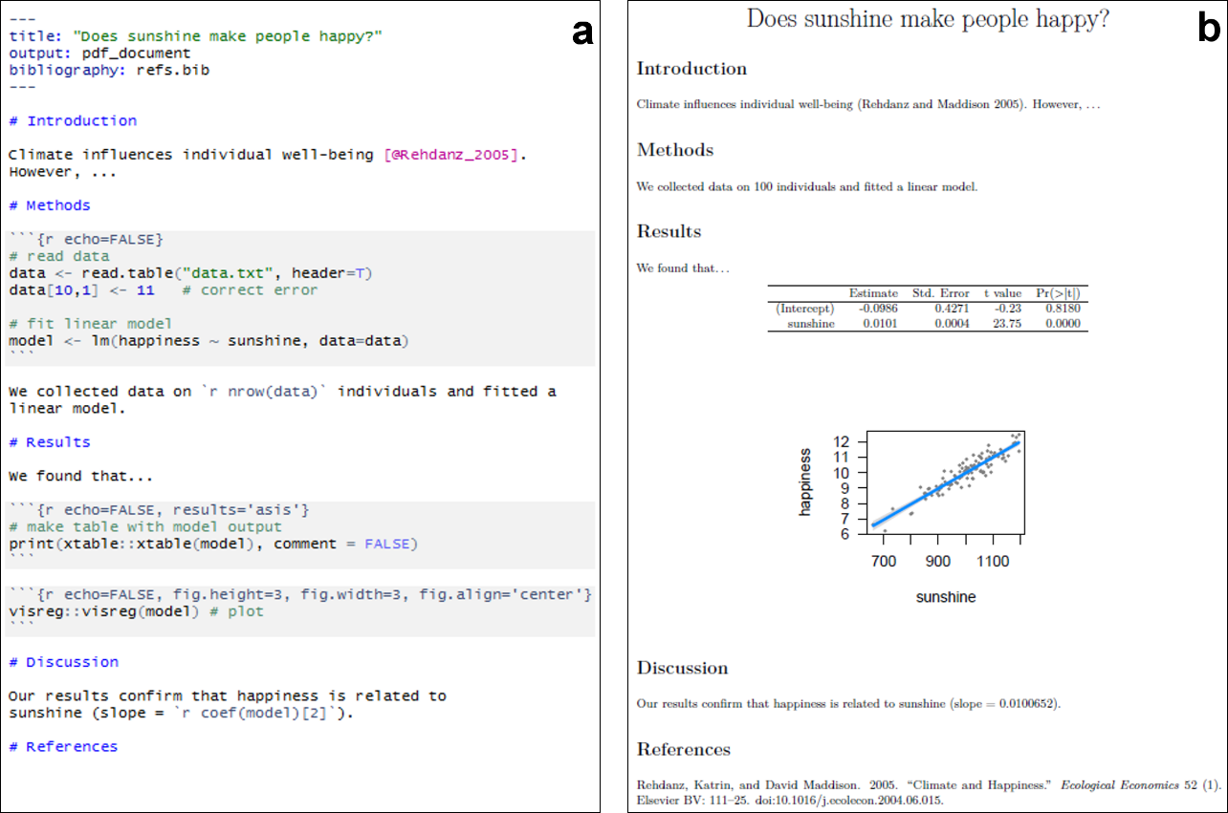
Why R Markdown?
R Markdown documents…
Prevent errors
Make reanalysis simple
Make sharing simple
3
https://frodriguezsanchez.net/post/writing-papers-in-rmarkdown/

Slide 4
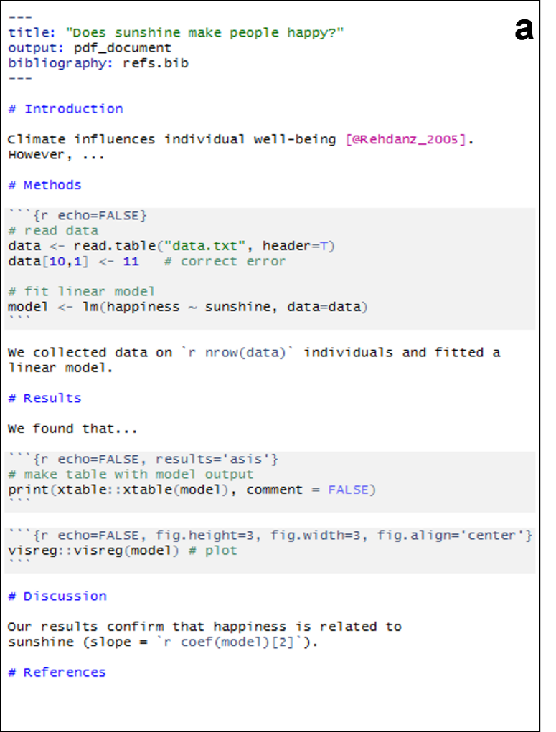
Basic Structure
An R Markdown report includes
Header section
Text chunks
Code chunks
4
https://frodriguezsanchez.net/post/writing-papers-in-rmarkdown/

Slide 5
Header Section
Will be automatically generated when you start a new report
Includes
Title
Author
Date
Output format (HTML, Word, PDF)
Other options
5

Slide 6
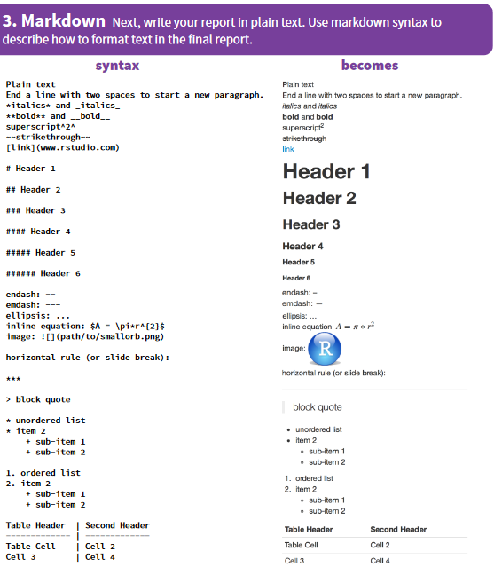
Text Formatting
Just type your report
R Markdown uses “markdown”-style formatting
All formatting is done in the text
For example, if you want to make something bold
In Word: Click “bold”, or CTRL+B
In R Markdown: **my text** -> my text
Plenty of other examples in this cheat sheet
(linked on Canvas)

Slide 7
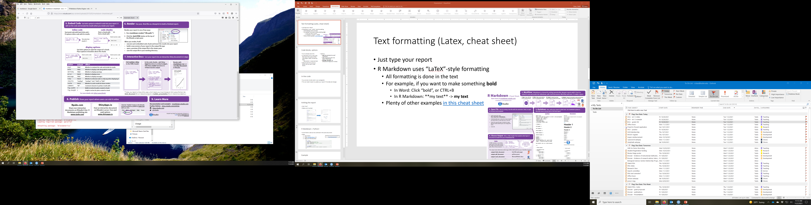
Code Chunks
You’ve already done this
A code chunk will run the code, then show the output of the code (figure, table, something else)
Best practice: 1 output per block
Data/results from previous blocks can be used in later blocks
Options
eval: Run (evaluate) the code? TRUE/FALSE
echo: Display the code in the report? TRUE/FALSE
fig.height, fig.width: Set dimensions for figure (#, in inches)
7

Slide 8
Putting it Together
8

